Slide 1
Chapter 7 Measurement & Data Processing
Wilt Gu

Slide 2
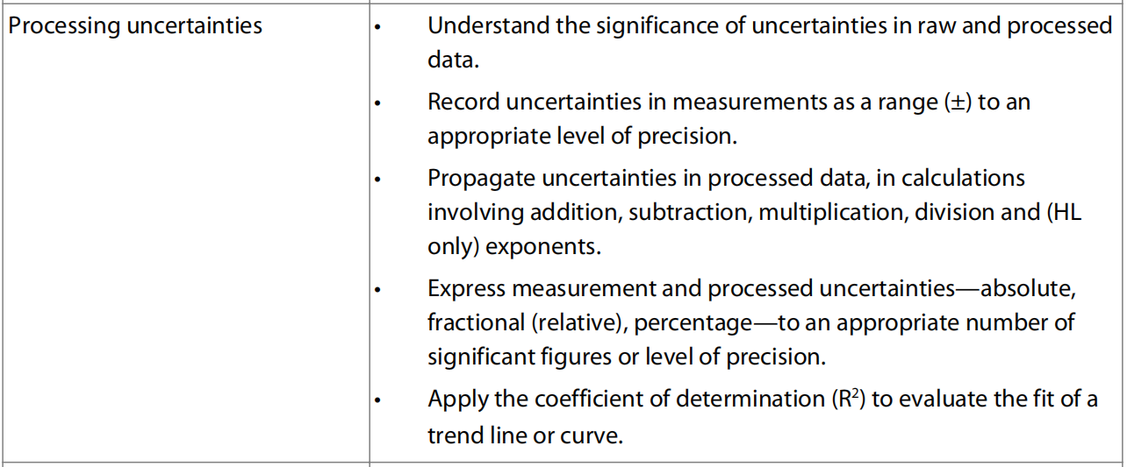
7.1 Uncertainties and errors in measurement and results

Slide 3
Uncertainty in Measurement
A digit that must be estimated is called uncertain.
A measurement always has some degree of uncertainty.

Slide 4
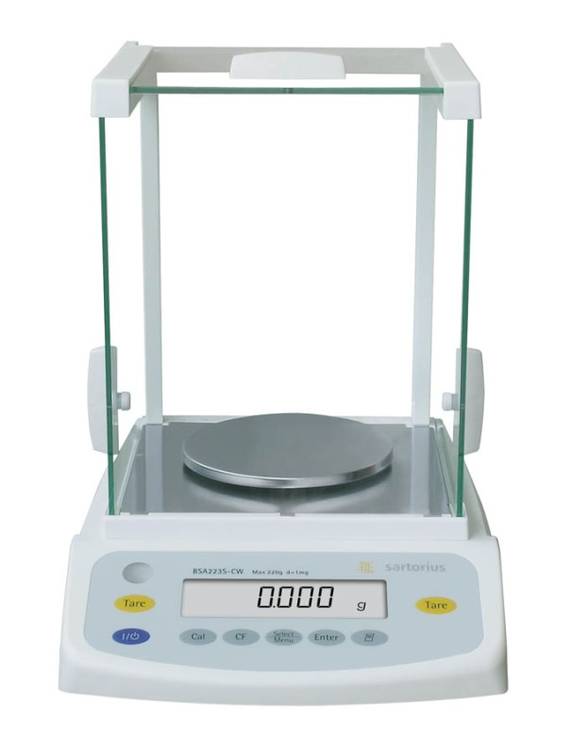
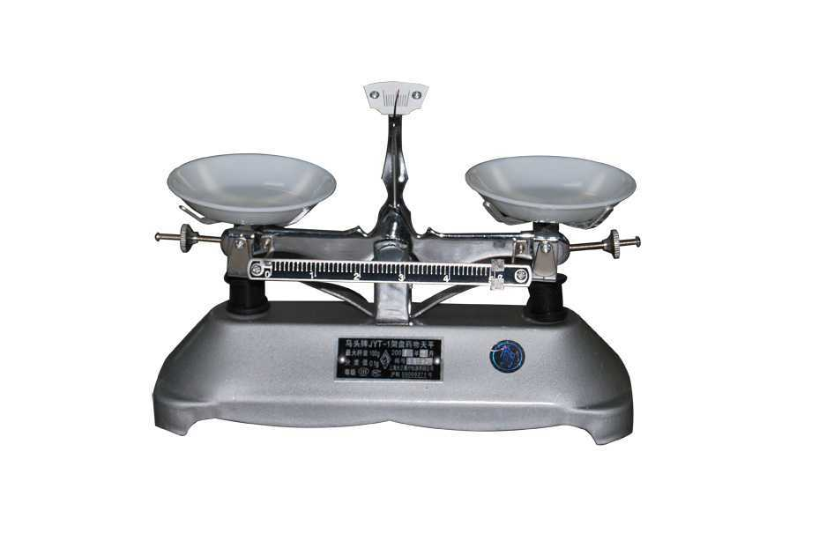
Why Is there Uncertainty?
Measurements are performed with instruments
No instrument can read to an infinite number of decimal places
Which of these balances has greater uncertainty in measurement?

Slide 5
Two Types of Measuring Apparatus
Analogue Instruments
Apparatus that contain calibration marks
E.g.: graduated cylinder, thermometer, buret
Digital Instruments
Instruments that show digital numbers
E.g.: Electronic balance, pH meter, voltmeter

Slide 6
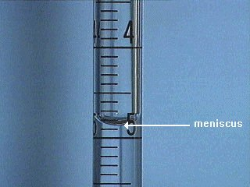
Reading the Meniscus
Analogue Instruments
Usually read volume from the bottom of the meniscus (mercury to be the contrary, reading on the top of the meniscus).
The meniscus is the curved surface of a liquid in a narrow cylindrical container.

Slide 7
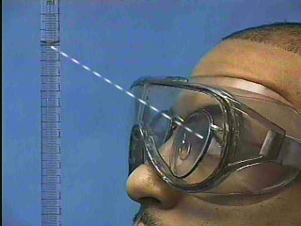
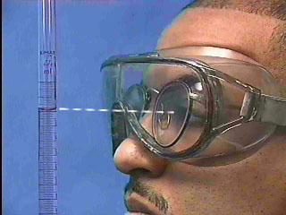
Avoid parallax errors
Parallax errors arise when a meniscus or needle is viewed from an angle rather than from straight-on at eye level.
Incorrect: viewing the meniscus from an angle
Correct: Viewing the meniscus at eye level

Slide 8
Measuring Volume
Determine the volume contained in a graduated cylinder by reading the bottom of the meniscus at eye level.
Read the volume using all certain digits and one uncertain digit.
Certain digits are determined from the calibration marks on the cylinder (or other apparatus).
The uncertain digit (the last digit of the reading) is estimated (only in how many halves of the smallest calibration mark).
The uncertainty equals to half of the smallest calibration mark

Slide 9
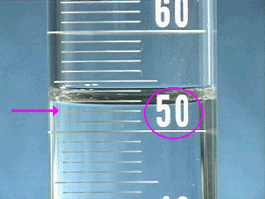
Use the graduations to find all certain digits
There are two unlabeled graduations below the meniscus, and each graduation represents 1 mL, so the certain digits of the reading are…
52 mL.

Slide 10
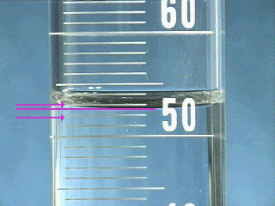
Estimate the uncertain digit and take a reading
The meniscus is about closer to the next graduation than the middle of the 2 of them, so the final digit in the reading is
1.0 mL.
The uncertainty of the measurement is the half of the smallest calibration mark (1 mL), so it is ± 0.5 mL
The volume in the graduated cylinder is
52.5 mL ± 0.5mL.

Slide 11
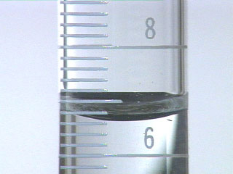
10 mL Graduate
What is the volume of liquid in the graduate?
6
_ . _ mL
6
±0.1 mL

Slide 12
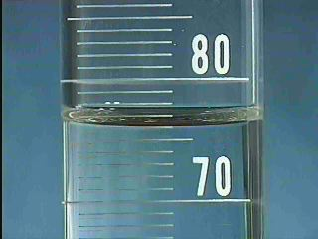
Self Test
Examine the meniscus below and determine the volume of liquid contained in the graduated cylinder.
The cylinder contains:
7
6
_ _ . _ mL± 0.5 mL
0

Slide 13
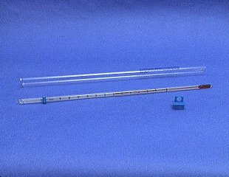
The Thermometer
Determine the temperature by reading the scale on the thermometer at eye level.
Read the temperature by using all certain digits and one uncertain digit.
Certain digits are determined from the calibration marks on the thermometer.
The uncertain digit (the last digit of the reading) is estimated (only in how many fifths of the smallest calibration mark).
The uncertainty equals to half of the smallest calibration mark
On most thermometers encountered in a general chemistry lab, the tenths place is the uncertain digit.

Slide 14
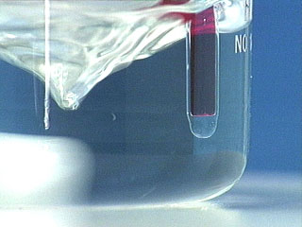
Do not allow the tip to touch the walls or the bottom of the flask.
If the thermometer bulb touches the flask, the temperature of the glass will be measured instead of the temperature of the solution. Readings may be incorrect, particularly if the flask is in a water bath or in an ice bath.

Slide 15
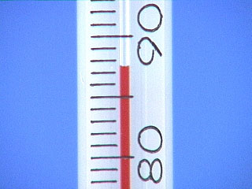
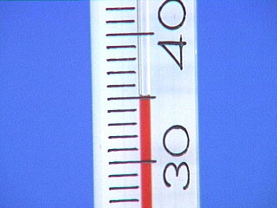
Reading the Thermometer
Determine the readings as shown below on Celsius thermometers:
_ _ . _ ℃±0.5℃
3
5
0
8
7
5
_ _ . _ ℃±0.5℃

Slide 16

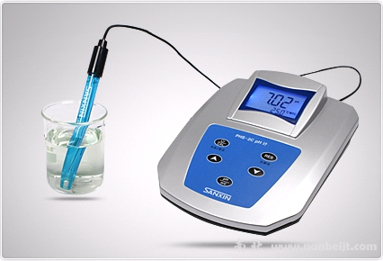
Digital Instruments

Slide 17
Balance Rules
In order to protect the balances and ensure accurate results, a number of rules should be followed:
Always check that the balance is zeroed before using it.
Never weigh directly on the balance pan. Always use a piece of weighing paper to protect it.
Do not weigh hot or cold objects.
Clean up any spills around the balance immediately.

Slide 18
Mass and uncertainty
Determine the mass by reading the numbers on the screen
Read the mass by using all digits on screen.
The uncertainty is ± 1 × 10 to the power of the last decimal place.
E.g. the data shown on the screen is 3.221 g, then the mass of the sample should be 3.221 ± 0.001 g
For the other digital instruments, the rules are the same for getting certain and uncertain digits as well as the uncertainty.

Slide 19
Other sources of uncertainty
Chemists are interested in measuring how properties change during a reaction and this can lead to additional sources of uncertainty.
When time measurements are taken for example, the reaction time of the experimenter should be considered.
Similarly there are uncertainties in judging, for example, the point that an indicator changes colour when measuring the equivalence point in a titration, or what is the temperature at a particular time during an exothermic reaction, or what is the voltage of an electrochemical cell.
These extra uncertainties should be noted even if they are not actually quantified when data are collected in experimental work.

Slide 20
Significant Figures
The digits in the measurement up to and including the first uncertain digit are the significant figures of the measurement.
There are two significant figures, for example, in 62 cm³ and five in 100.00 g.
The zeros are significant here as they signify that the uncertainty range is (±) 0.01 g.
The number of significant figures may not always be clear.
If a time measurement is 1000 s, for example, are there one, two, three, or four significant figures?
As this is ambiguous, scientific notation is used to remove any confusion as the number is written with one non-zero digit on the left of the decimal point.

Slide 21
Rules for Counting Significant Figures - Details
Nonzero integers always count as significant figures.
3456 has
4 significant figures

Slide 22
Rules for Counting Significant Figures - Details
Zeros
Leading zeros do not count as
significant figures.
0.0486 has
3 significant figures

Slide 23
Rules for Counting Significant Figures - Details
Zeros
Captive zeros always count as
significant figures.
16.07 has
4 significant figures

Slide 24
Rules for Counting Significant Figures - Details
Zeros
Trailing zeros are significant if the number contains a decimal point.
9.300 has
4 significant figures
450. has
3 significant figures

Slide 25
Rules for Counting Significant Figures - Details
Zeros
You can never tell whether trailing zeros are significant or not if the number does not contain a decimal point.
9300 could have
2 or 3 or 4 significant figures

Slide 26
Rules for Counting Significant Figures - Details
Zeros
To avoid this kind of ambiguity, scientific notation can be used to express the number
9.3 × 10³ has
2 significant figures
9.30 × 10³ has
3 significant figures
9.300 × 10³ has
4 significant figures

Slide 27
Rules for Counting Significant Figures - Details
Exact numbers have an infinite number of significant figures.
1 inch = 2.540000000 cm, exactly
1 mol of ¹²C = 12.000000000 g, exactly

Slide 29
Significant Figures Practice #1
How many significant figures in each of the following?
1.0070 m →
5 sig figs
17.10 kg →
4 sig figs
100,890 L →
5 or 6 sig figs
3.29 x 10³ s →
3 sig figs
0.0054 cm →
2 sig figs
3,200,000. →
7 sig figs

Slide 30
Rules for Significant Figures in Mathematical Operations
Addition and Subtraction: The number of decimal places in the result equals the number of decimal places in the least precise measurement.
6.8 + 11.934 =
18.734 → 18.7 (3 sig figs)

Slide 31
Rules for Significant Figures in Mathematical Operations
Multiplication and Division: number of significant figures in the result equals the number in the least precise measurement used in the calculation.
6.38 x 2.0 =
12.76 → 13 (2 sig figs)

Slide 32
Significant Figures Practice #3
Calculation
Calculator says:
Answer
3.24 m + 7.0 m
10.24 m
10.2 m
100.0 g - 23.73 g
76.27 g
76.3 g
0.02 cm + 2.371 cm
2.391 cm
2.39 cm
713.1 L - 3.872 L
709.228 L
709.2 L
1818.2 lb + 3.37 lb
1821.57 lb
1821.6 lb
2.030 mL - 1.870 mL
0.16 mL
0.160 mL

Slide 33
Significant Figures Practice #2
Calculation
Calculator says:
Answer
3.24 m x 7.0 m
22.68 m²
23 m²
100.0 g ÷ 23.7 cm³
4.219409283 g/cm³
4.22 g/cm³
0.02 cm x 2.371 cm
0.04742 cm²
0.05 cm²
710 m ÷ 3.0 s
236.6666667 m/s
2.4 x 10² m/s
1818.2 lb x 3.23 ft
5872.786 lb·ft
5.87 x 10³ lb·ft
1.030 g x 2.87 mL
2.9561 g/mL
2.96 g/mL

Slide 34
Types of Error
Whenever you see an error, there must be a true value/theoretical value to compare!
Random Error (Indeterminate Error) - measurement has an equal probability of being high or low and this is unavoidable in measurements.
Systematic Error (Determinate Error) - Occurs in the same direction each time (high or low), often resulting from poor technique or incorrect calibration.

Slide 35
Random Error
When an experimenter approximates a reading, there is an equal probability of being too high or too low. This is a random error.
Random errors are caused by:
instrument imprecision
fluctuations during readings
human reaction time
the observer misinterpreting the reading.

Slide 36
Random Error
As they are random, the EFFECT of random errors can be reduced through repeated measurements. BE AWARE NOT the random errors themselves.
The readings that are randomly too high will be balanced by those that are too low if sufficient readings are taken.
If the same person duplicates the experiment with the same result the results are repeatable.
If several experimenters duplicate the results they are reproducible.

Slide 37
Suppose the mass of a piece of magnesium ribbon is actually 0.1234 g, then when it is measured several times and the following results obtained:
0.1234 g 0.1232 g 0.1233 g 0.1234 g 0.1235 g 0.1236 g
The mass is reported as 0.1234 (±) 0.0002 g as it is in the range 0.1232 to 0.1236 g.

Slide 38
Systematic Error
Systematic errors occur as a result of poor experimental design or procedure.
Systematic errors CANNOT be reduced by repeating the experiments.
Systematic errors can be reduced by more careful experimental design, more accurate experimental apparatus, or correct procedures in experiments.

Slide 39
Systematic Error
Examples of systematic errors include the following:
Measuring the volume of water from the top of the meniscus rather than the bottom will lead to volumes which are too high
Overshooting the volume of a liquid delivered in a titration will lead to volumes which are too high
Using an acid–base indicator whose end point does not correspond to the equivalence point of the titration
Heat losses in an exothermic reaction will lead to smaller temperature changes.

Slide 40
Suppose the top pan balance was incorrectly zeroed in the previous example and the following results were obtained:
0.1236 g 0.1234 g 0.1235 g 0.1236 g 0.1237 g 0.1238 g
All the values are too high by 0.0002 g.

Slide 41
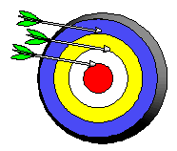
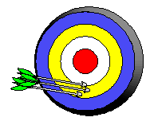
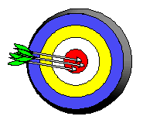
Precision and Accuracy
Accuracy refers to the agreement of a particular value with the true value.
Precision refers to the degree of agreement among several measurements made in the same manner.
Neither accurate nor precise
Precise but not accurate
Precise AND accurate

Slide 43
Errors related to precision & accuracy
Large random errors lead to a worse precision, but with sufficient data it will less affect on the accuracy of the result.
Large systematic errors lead to a worse accuracy, but it will not affect on the precision of the result.

Slide 44
Error and Uncertainty
Errors and uncertainties are definitely different concepts.
An uncertainty of 1 s is more significant for time measurements of 10 s than it is for 100 s.
It is helpful to express the uncertainty using absolute, fractional or percentage values.

Slide 45
The percentage uncertainty should not be confused with percentage error.
Percentage error is a measure of how close the experimental value is to the theoretical or accepted value.
Percentage error
= |experimental value – theoretical value| / theoretical value × 100%

Slide 46
Types of Uncertainty
The absolute uncertainties is the actual uncertainty in the value, e.g. 28.50±0.05
The percentage uncertainties is the absolute uncertainty expressed as a percentage of the value, e.g. the percentage uncertainty of 28.50±0.05 is ±0.18% (0.05÷28.50×100%).

Slide 47
Calculation of Uncertainty
Add absolute uncertainties when adding or subtracting numbers.
Add percentage uncertainties when multiplying or dividing numbers, and then multiply percentage uncertainties by the value to get the absolute uncertainties of the final result.
Multiply percentage uncertainties by the value of the exponent (power) in calculations involving exponents. For instance, if the raw data is cubed (raised to the third power), then propagating its uncertainty involves multiplying the percentage uncertainty by three (HL only).

Slide 48
The uncertainties always have ONLY ONE significant figure and need to have the same decimal place as the numbers.
If the calculated results violate this rule then adjustment needs to be applied.
0.132±0.0022 = 0.132±0.002
0.132±0.022 = 0.13±0.02
0.132±0.0002 = 0.132±0.000

Slide 51
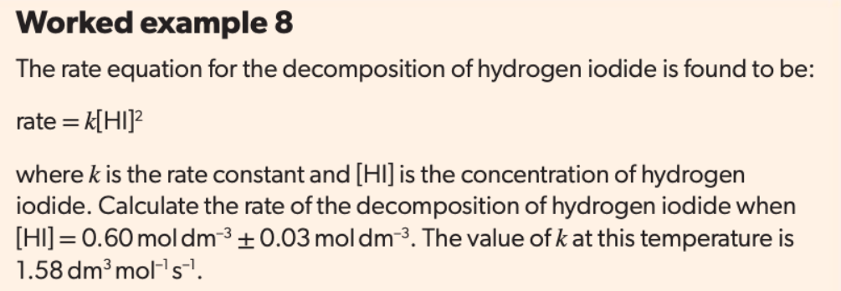
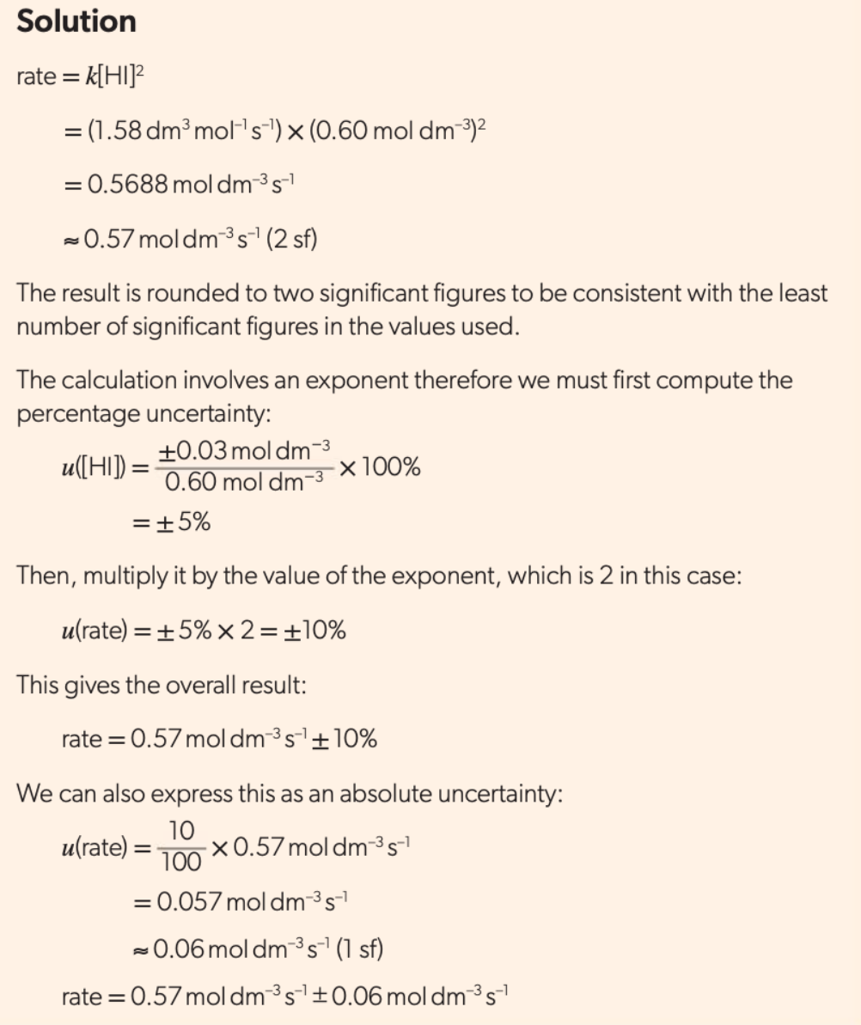

Slide 52
The density should only be given to two significant figures given the uncertainty in the mass and volume values, as discussed in the next section.
The uncertainty in the calculated value of the density is 7% (given to one significant figure).
This is equal to the sum of the uncertainties in the mass and volume values: (5% + 2% to the same level of accuracy).
This approximate result provides us with a simple treatment of propagating uncertainties when multiplying and dividing measurements.
When multiplying or dividing measurements, the total percentage uncertainty is the sum of the individual percentage uncertainties.
The absolute uncertainty can then be calculated from the percentage uncertainty.

Slide 53
Exercise:
What is the concentration of the solution when preparing with 2.541±0.001 g of NaCl to have 100.00mL ±0.02 mL of solution? (ρ_{solution} = 0.997±0.001 g/cm³,
Mr_{Na} = 22.989770±0.000001,
Mr_{Cl} = 35.453±0.001)

Slide 54
Calculation of Uncertainty
C = n / V
= (m / M) / V
= 2.541 / (22.989770 + 35.453) / 0.10000
= 2.541 / 58.443 / 0.10000
= 0.4347826
=0.4348 mol·dm⁻³

Slide 55
Calculation of Uncertainty
Uncertainty of M_{NaCl} = 0.000001 + 0.001 = 0.001
% Uncertainty of M_{NaCl} = 0.001 / 58.443 × 100% = 0.00171%
% Uncertainty of m = 0.001 / 2.541 × 100% = 0.0394%
% Uncertainty of V = 0.02 / 100.00 × 100% = 0.02%
% Uncertainty of the result = 0.00171 + 0.0394 + 0.02 = 0.06111%
Uncertainty of the result = 0.4348 × 0.06111% = 0.0002657 = 0.0003
Thus the result should be: 0.4348 ± 0.0003

Slide 56
Discussing errors and uncertainties
An experimental conclusion must take into account any systematic errors and random uncertainties.
You should recognize when the uncertainty of one of the measurements is much greater than the others as this will then have the major effect on the uncertainty of the final result.
The approximate uncertainty can be taken as being due to that quantity alone.

Slide 57
In thermometric experiments, for example, the thermometer often produces the most uncertain results, particularly for reactions which produce small temperature differences.
Can the difference between the experimental and literature value be explained in terms of the uncertainties of the measurements or were other systematic errors involved?
This question needs to be answered when evaluating an experimental procedure. Heat loss to the surroundings, for example, accounts for experimental enthalpy changes for exothermic reactions being lower than literature values.
Suggested modifications, such as improved insulation to reduce heat exchange between the system and the surroundings, should attempt to reduce these errors.
This is discussed in more detail in Chapter 5.

Slide 58
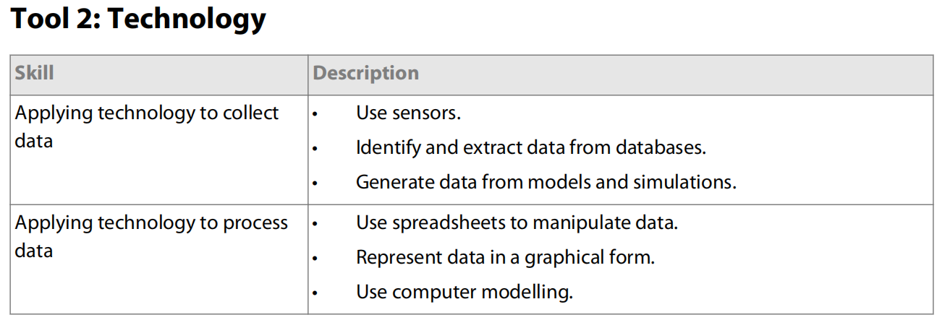
7.2 Technologies

Slide 59
Sensors
Sensors are digital devices that can be used to measure physical properties and transmit the results electronically. Common sensors in school chemistry labs include temperature probes, pH probes, light sensors and conductivity probes. Digital sensors and other devices, such as colorimeters, are convenient because they:
provide a practical and easy way to measure certain properties that would otherwise require bulky equipment or time-consuming analyses (for example, light sensors or dissolved oxygen sensors)
often produce more precise results than the alternative equipment or traditional laboratory techniques (for example, pH sensors as compared to acid–base indicators)
can be connected to data loggers that collect and save large amounts of data at regular intervals.

Slide 60
However, sensors often require calibration before use. If you are going to use one, find out how to calibrate it by checking the manual first. Colorimeters and pH probes are examples of digital devices that require frequent calibration.
Smart phones also contain sensors, and along with certain apps they can make useful measurements in a chemistry lab.
Because phones are items that people frequently touch and carry outside the laboratory, care must be taken to keep them well away from hazards.
A 3D-printed cuvette holder could be designed for sturdier support of the analyzed sample.

Slide 61
Spreadsheets (Excel)
Spreadsheets are powerful data manipulation and analysis tools that you can use for entering and processing large amounts of data. Operators, formulas and functions tell the software to perform certain operations. Even with a small selection of simple operators, spreadsheets will help you to process experimental data quickly and efficiently.
Figure 59 shows two screenshots of an Excel spreadsheet. The values in the last two columns shown in the first screenshot have been calculated automatically using the formulas shown in the same columns of the second screenshot.
Note that each formula in Excel begins with an equal sign (=) followed by cell references (e.g. E7) and operators, such as multiplication (*) and division (/).
Brackets are used to change the order of operations. Note that all processed values should be strictly numerical because most operators in Excel do not recognize numbers that are entered into the same cell as letters.

Slide 62
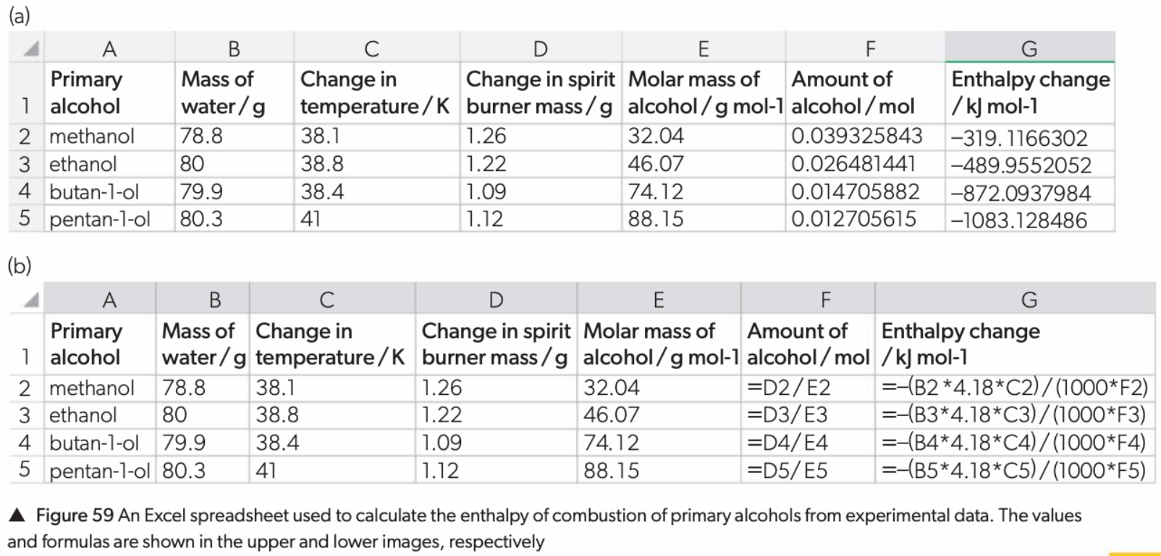

Slide 63
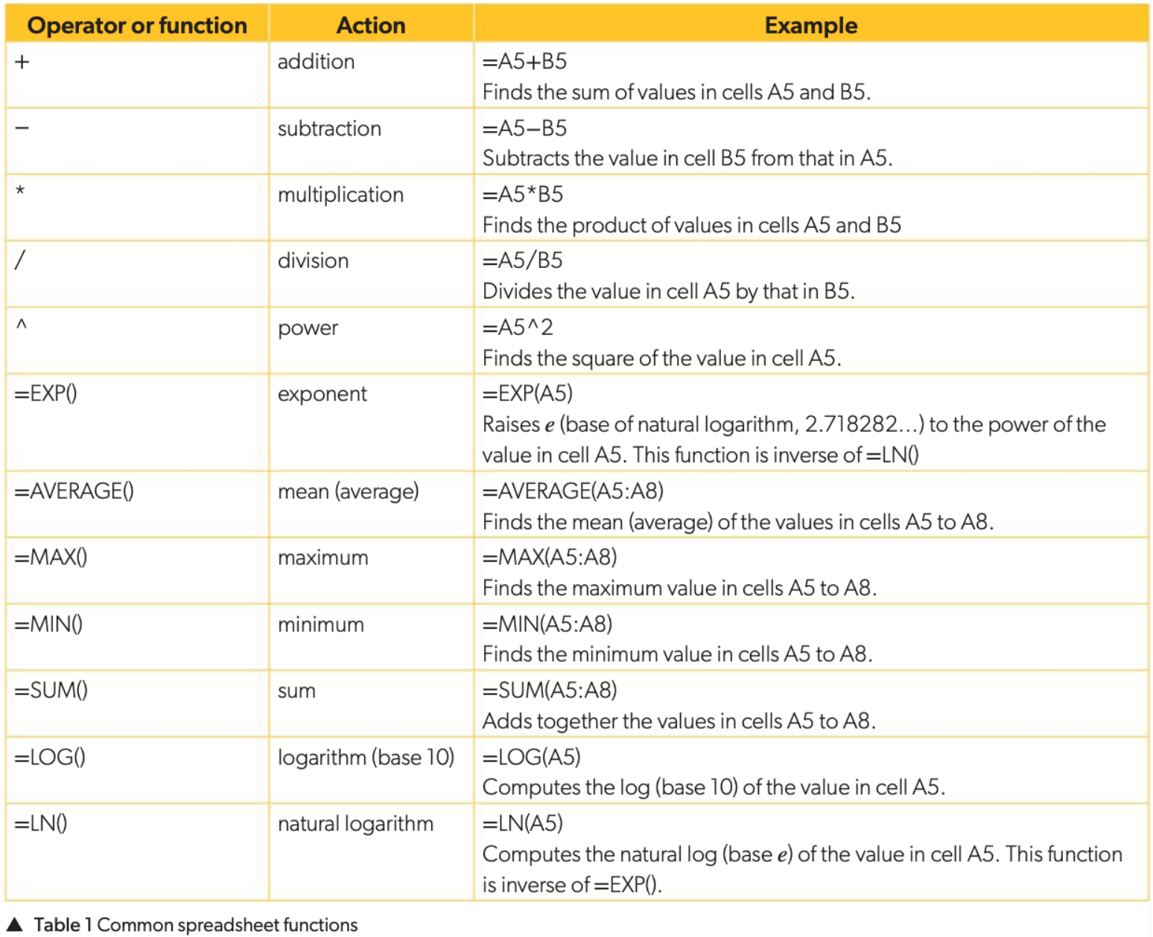

Slide 64
More advanced spreadsheet functions that you might want to explore next could involve sorting data, conditional formatting, inserting scroll bars, vertical lookup, recording macros, etc.
You can easily plot various types of graphs in spreadsheets. Remember to include all the features of good-quality graphs.
Most spreadsheets and graphing software packages can be used to plot a simple scatter plot, line of best fit and error bars.
Plotting different error bars on each point, drawing curves of best fit, and omitting certain points from the line of best fit are also functions that can be used in Excel.

Slide 65
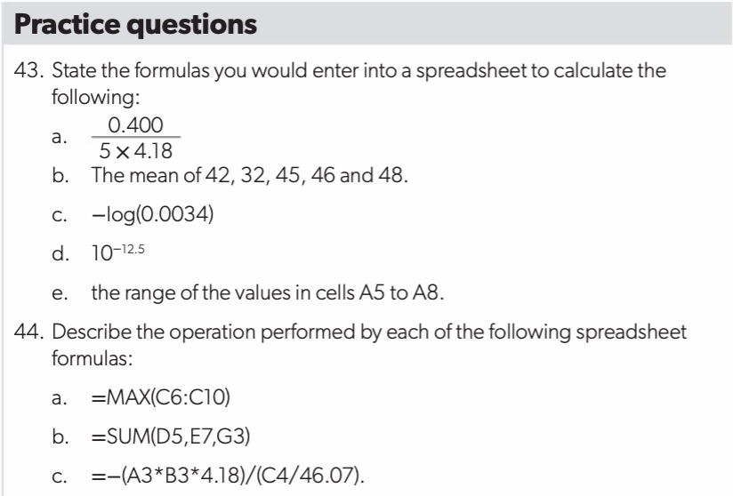
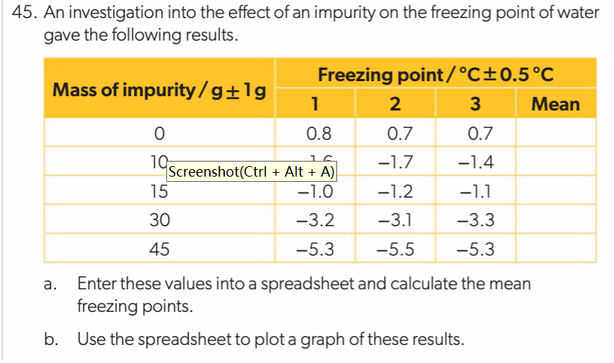

Slide 66
Databases
Databases are digital repositories of large amounts of information, all organized to facilitate retrieval and continuous updates. In chemistry you might use databases to gather information on:
Elements and their properties (e.g. WebElements, created by Mark Winter at the University of Shefield, UK)
Physical properties (e.g. Chemspider, created by the Royal Society of Chemistry, UK)
Energetics data (e.g. NIST Chemistry WebBook, edited by Linstrom and Mallard at the National Institute of Standards and Technology, USA)
Spectral data (e.g. SDBSWeb, created by the National Institute of Advanced Industrial Science and Technology, Japan)
Molecular geometry data (e.g. CoolMolecules, created by Hanson et al. at St. Olaf College and Washington State University, USA).
Almost all combined data (e.g. Lange’s Handbook of Chemistry, edited by James Speight at MgGraw-Hill companies, USA)

Slide 67
You may use databases to look up two or three entries at a time, but sometimes you will conduct more complex database investigations involving large amounts of data.
These tips will help you when extracting data from databases as part of extended investigations:
Spend some time exploring the database to get a sense of the types of data that are available.
Make a note of the search terms and search parameters you can use.
Organize the data you collect into a spreadsheet as you go along.
Many databases cite the original information source, so you should note this as well as the reference to the database itself.

Slide 68
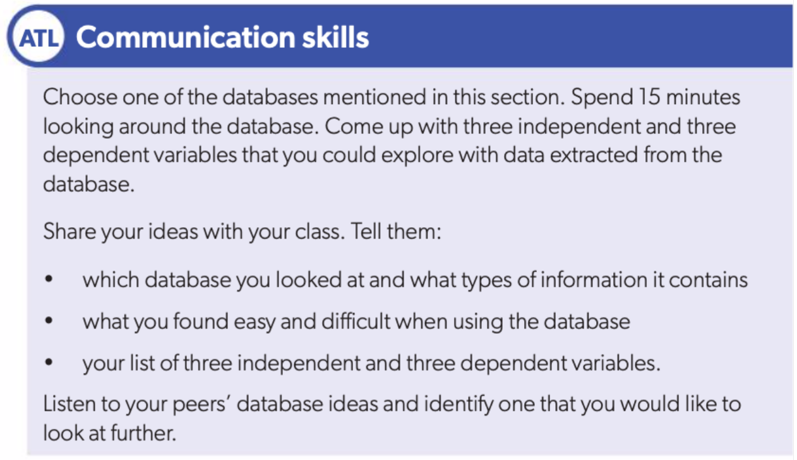

Slide 69
Modelling
You have already come across models in your study of chemistry, for instance the ideal gas model, or atomic models.
Scatter graphs help us model the relationship between two variables.
With the aid of technology, scientists can model the structure and reactivity of intricate chemical phenomena.
The best way to develop a model is to start with a simple relationship or concept and build up from there. Here we will look at two examples of modelling tasks that are facilitated by technology: spreadsheet modelling and molecular mechanics.

Slide 70
Spreadsheet modelling
Spreadsheets can be set up to transform input variables into output variables in the context of a given system, such as equilibria. You can explore the effect of external disturbances on equilibrium concentrations, for example. US chemist Charles Marzzacco proposed an introductory spreadsheet model of a simple coin-flipping equilibrium:
k_{f}
heads (H) ⇌ tails (T)
k_{r}
The input parameters are the initial concentrations of H and T, and the forward and reverse rate constants, k_{f} and k_{r}. These parameters then determine the H and T concentrations over time, from which a concentration vs time graph is generated. We can now explore the effects of changing the initial concentrations and the rate constants on the equilibrium concentrations and the equilibrium constant, K.
The resulting spreadsheet values and formulas are shown in Figure 60. Here we have added scrollbars to the spreadsheet, as well as a calculation of the equilibrium constant, K, from the forward and reverse rate constants k_{f} and k_{r}, where K=k_{f}/k_{r}.

Slide 71
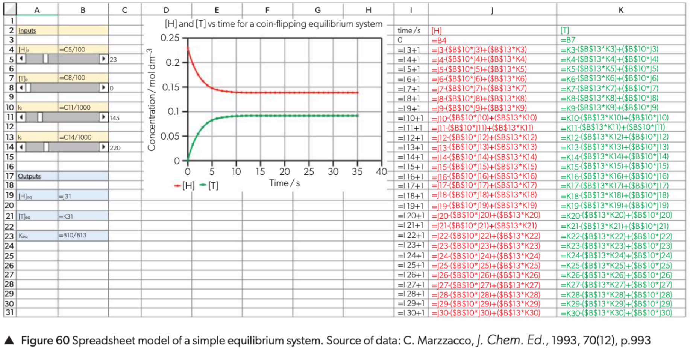

Slide 72
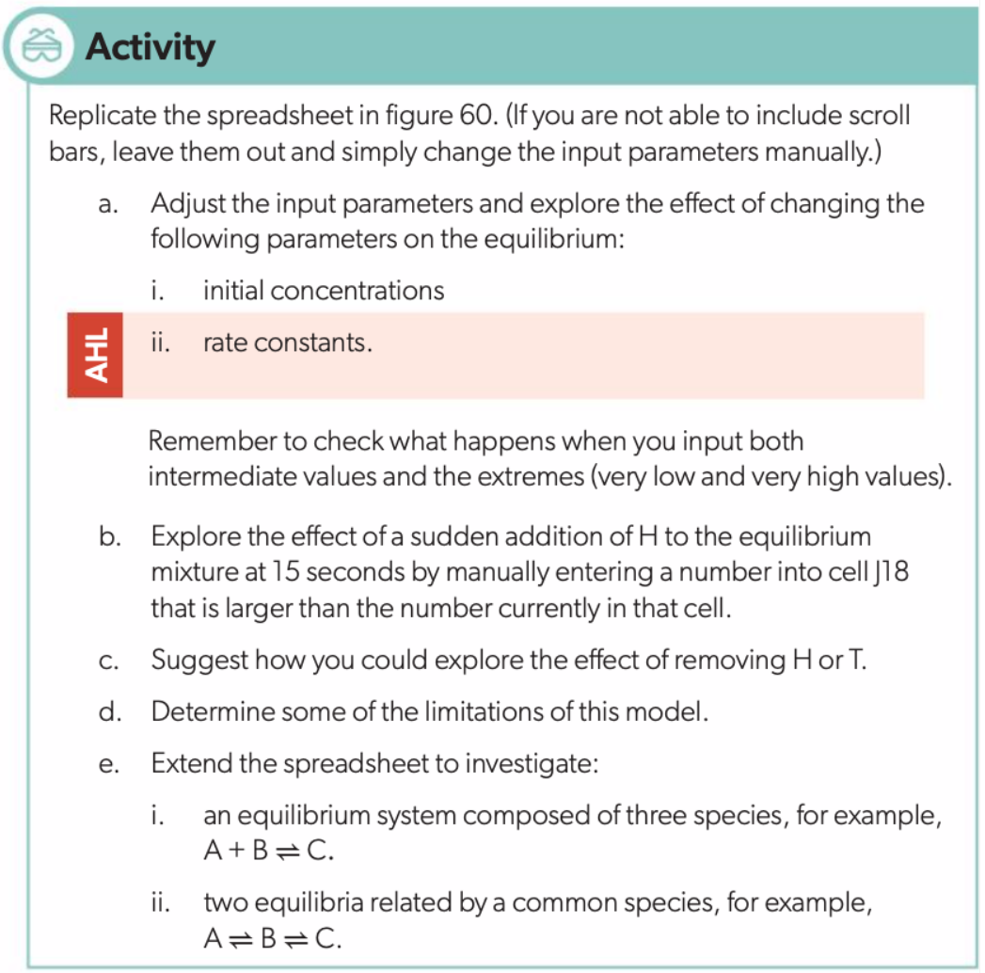

Slide 73
Molecular mechanics
The development of molecular modelling has profoundly impacted our understanding of chemistry by greatly extending the scope of what chemists can “see” and study. Here we will introduce molecular mechanics, which is a field of molecular modelling that treats atoms as balls joined by springs, in line with classical mechanics.
A more complex area of molecular modelling, which is beyond the scope of the DP chemistry course, involves the use of quantum mechanical principles to study the distribution of electron density in reacting species.
Figure 61 shows molecular models of water, methanol and methoxymethane, which can be analysed to explore the effect of substituents bonded to the oxygen on the R–O–R′ bond angle. The bond angle data derived from each model are shown in table 2.

Slide 74
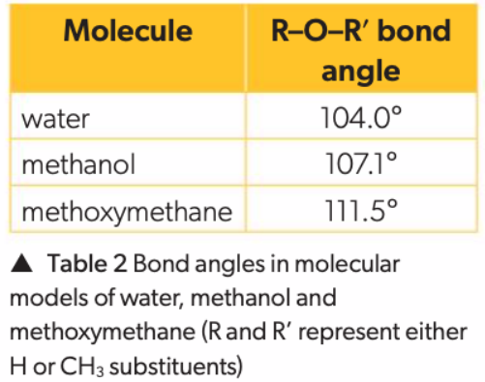
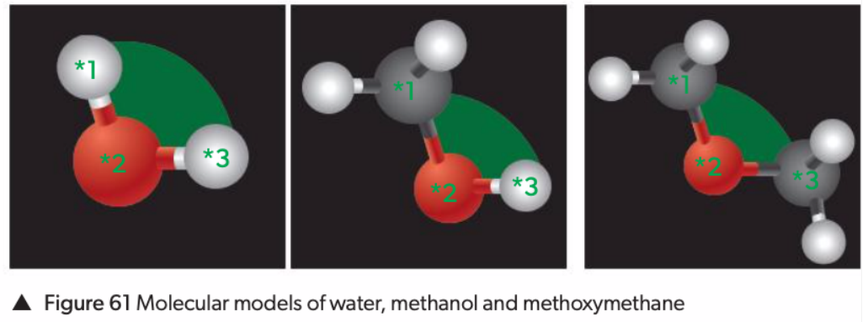

Slide 75
Figure 62 shows a model of two water molecules approaching one another.
For each distance, the potential energy between the two water molecules was calculated. This is summarized in table 3.
To begin with, the hydrogen atom in one molecule is located 15.5Å (or 15.5×10⁻¹⁰ m) from the oxygen atom in the other molecule, and the potentialenergy between the two molecules is –0.15kJ mol⁻¹.
As the molecules approach each other, the distance and energy both decrease until a hydrogen bond is formed.
The model predicts that the hydrogen bond will have a length of 1.78Å (or 1.78×10⁻¹⁰m) and an energy of –27.7kJ mol⁻¹.
The validity of the model can be verified by comparing these predicted values with experimental data.

Slide 76
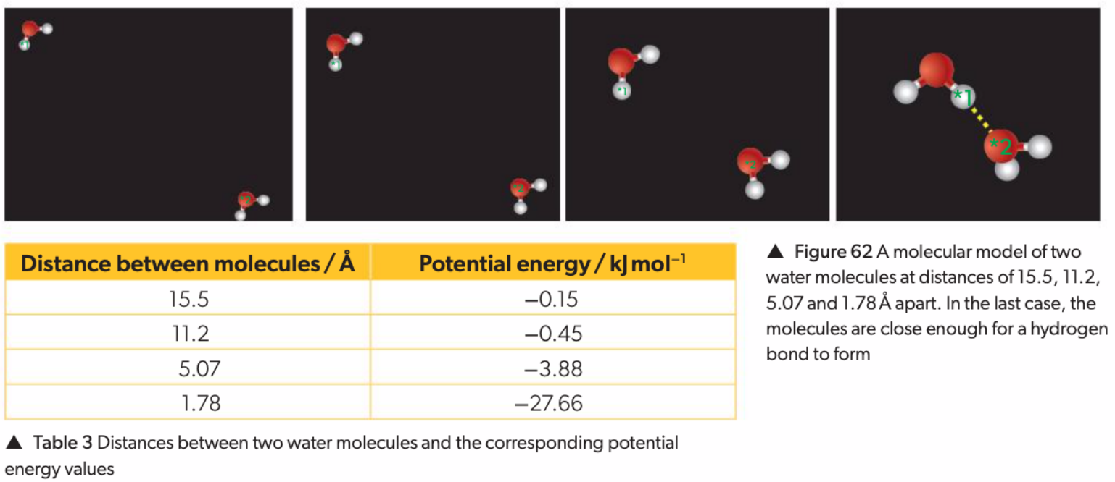

Slide 77
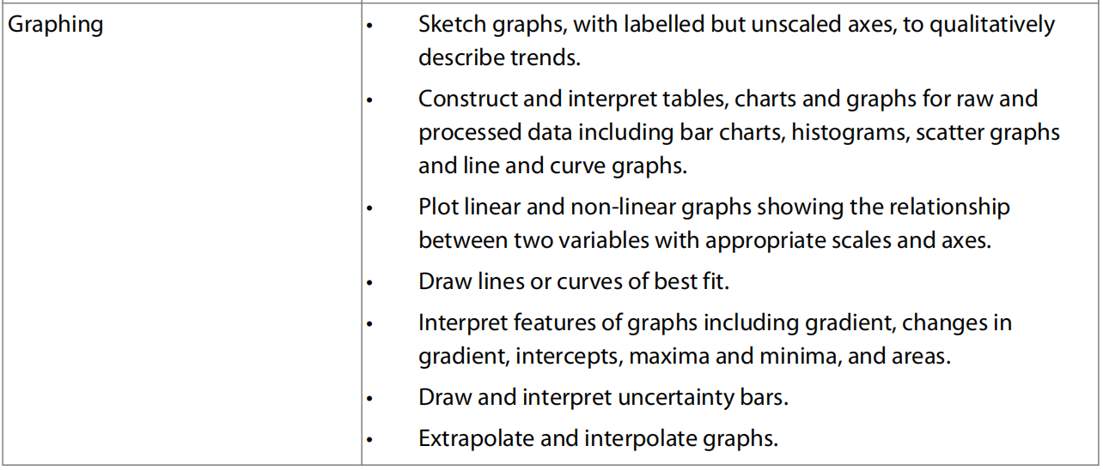
7.3 Graphical Techniques

Slide 78
Tables
Quantitative data can be presented as a table. It is customary to include the following features in data tables:
Descriptive title to aid communication. If more than one table is being presented, each should be numbered as well.
Independent variable in the leftmost column, listed in order of increasing value.
Dependent variable(s) in the columns to the right of the independent variable. List the results from repeating trials next to each other, and the mean in the rightmost column.
Descriptive column headings.
Units and uncertainties in column headings.
Consistent precision in each column.
Clear identification of values of importance (for example, concordant values in a titration, or anomalous results).

Slide 79
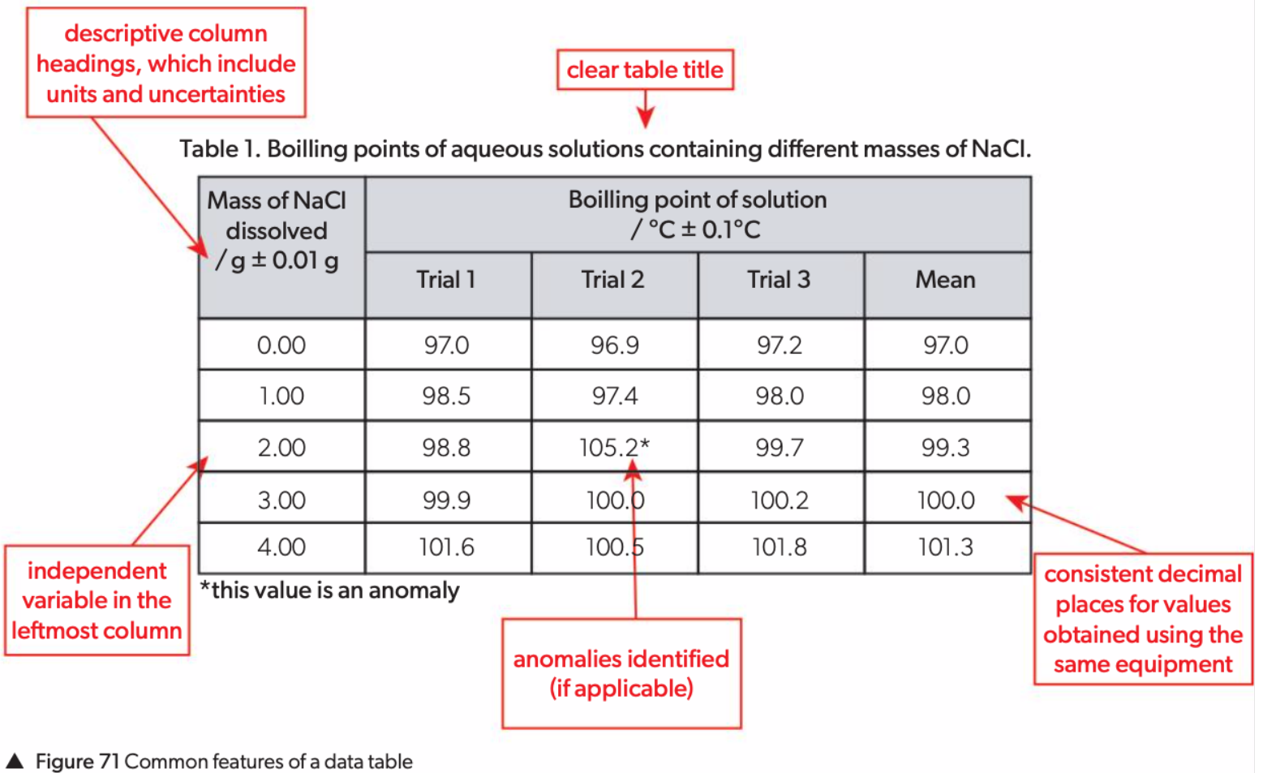

Slide 80
Control variables should be recorded but they are not usually included in tables because they should not change throughout the experiment.
Tables can sometimes include a space for qualitative data, where applicable. Otherwise, qualitative data can be included directly above or below the table.
Sometimes you will need to think of a way to effectively record additional information in your table (such as variables that need to be monitored or citations for data that you have found in databases).
You can find examples of how to do this in scientific journal articles.

Slide 81
Charts and Graphs
A chart or a graph is often the best method of presenting and analysing data.
It shows the relationship between
the independent variable plotted on the horizontal axis
and the dependent variable on the vertical axis and gives an indication of the reliability of the measurements.
Charts and graphs represent all the data simultaneously, allowing us to explore trends and patterns in the data.

Slide 82
There are different types of charts and graphs, each used to present information in a way that aids interpretation. Examples include:
Pie charts allow us to compare parts of a whole, usually expressed as percentages.
Bar charts are used to group data into distinct categories known as categorical variables, such as type of intermolecular forces, or identity of a substituent atom.
Histograms involve grouping data according to a range in the value of the quantitative variable such as length (e.g. 0–1 cm, 1–2cm, 2–3cm).
Line graphs also show quantitative data, but they contain points joined by straight lines. Line graphs are particularly useful for continuous data, which means that they can be organized along a numbered line and have any value within a continuous range.
Scatter graphs represent the relationship between two variables. The data points are plotted and then a line or curve of best fit (also known as a trendline) is added to show the relationship between the two variables. Unlike line graphs, the points on scatter graphs are not necessarily joined up because what matters is the overall relationship they show.

Slide 83
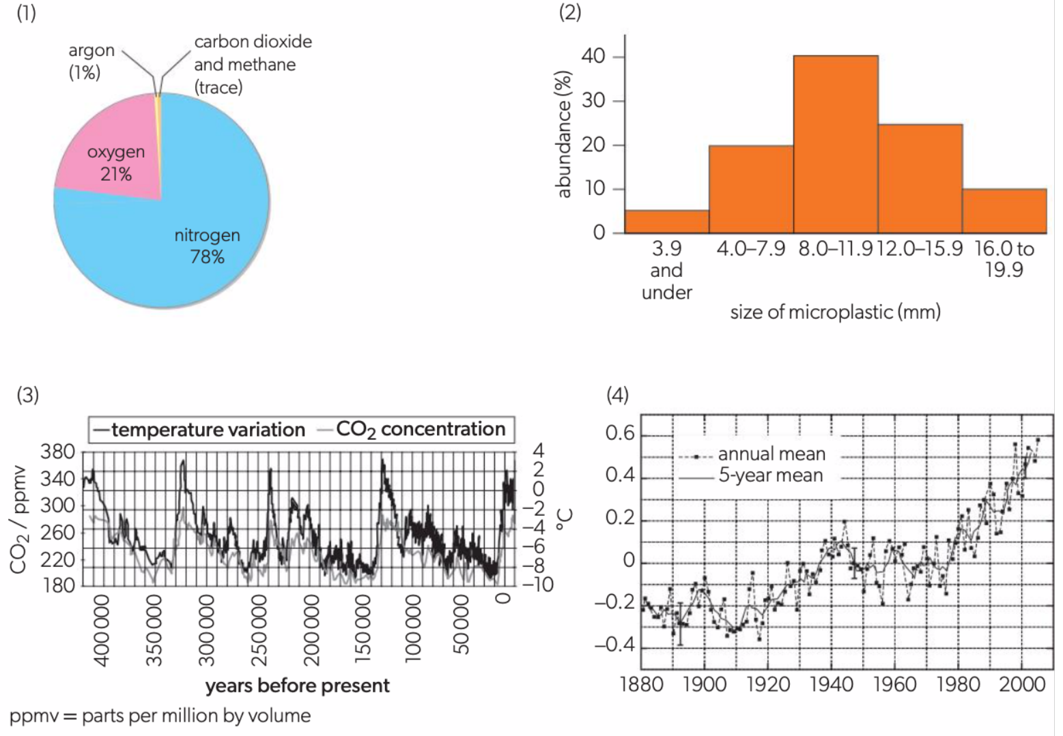

Slide 84
Sketched graphs are used to show qualitative trends
Some of the graphs have labelled but unscaled axes.
These are called sketched graphs, and are generally used to show qualitative trends, such as when variables are proportional or inversely proportional.
Drawn graphs used to present experimental data must have labelled and scaled axes if they are going to be used to display quantitative measurements.

Slide 85
Plotting scatter graphs
When you draw a graph you should:
Give the graph a title.
Label the axes with both quantities and units.
Use the available space as effectively as possible.
Use sensible linear scales – there should be no uneven jumps.
Plot all the points correctly.
A line of best fit should be drawn smoothly and clearly. It does not have to go through all the points but should show the overall trend.
Identify any points which do not agree with the general trend.
Think carefully about the inclusion of the origin. The point (0, 0) can be the most accurate data point or it can be irrelevant.

Slide 86
Data sometimes contains outliers, which are points that do not fit the trend of the line or curve. Sometimes scientists use advanced statistical tests to determine outliers. At this level, you can identify outliers by eye.
When discussing your results, it is important to consider possible underlying causes of an outlier.
Logarithmic scales can be used when plotting data that cover a very large range.
Doing so compacts the information in the graph and allows us to easily identify significant changes in the data.

Slide 87
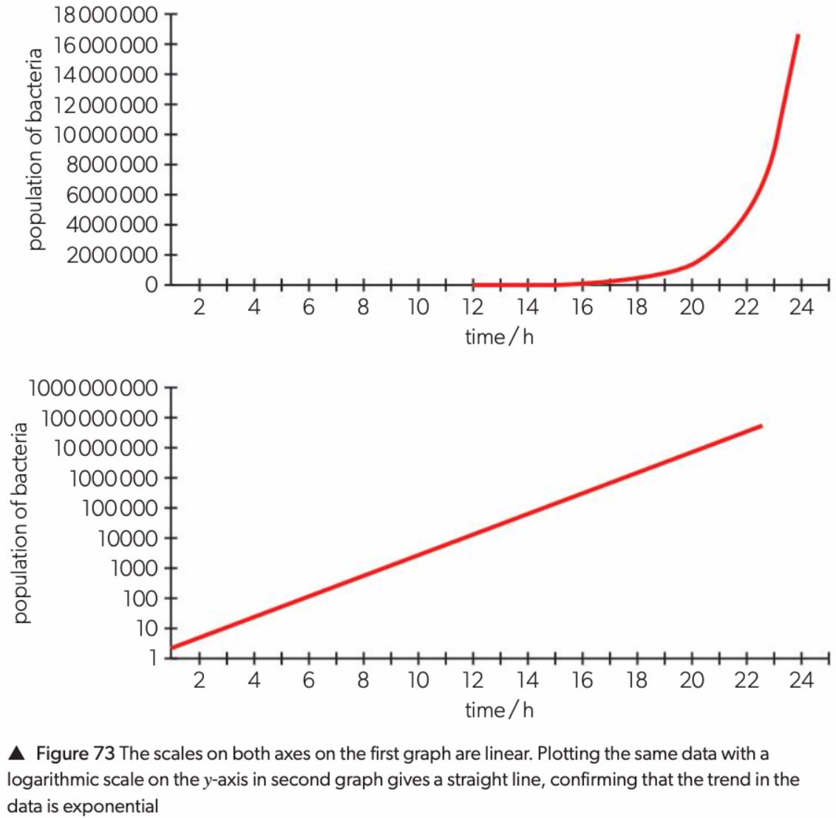

Slide 88
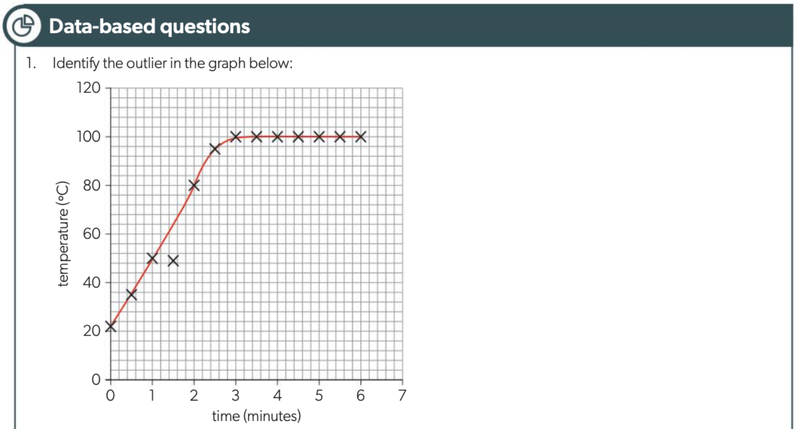

Slide 89
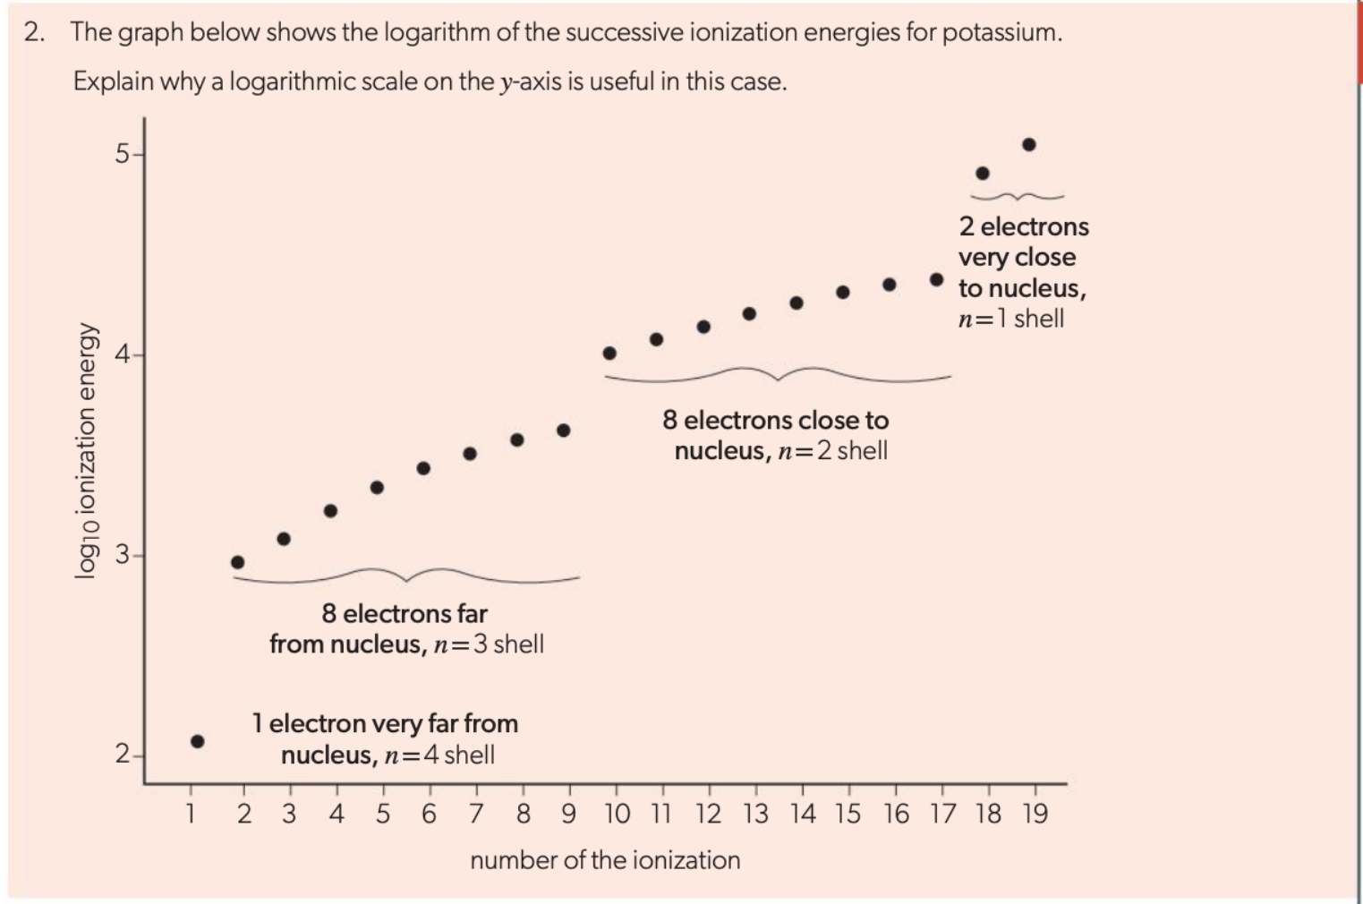

Slide 90
The ‘best-fit’ line or curve
A line or curve of best fit represents the general trend in a graph and can be used for further analysis of the relationship between the variables. The line or curve of best fit does not have to pass through every single point, but it must have roughly the same number of points on either side of it.
If there are any obvious outliers amongst your data, you might need to ignore them when drawing the line or curve of best fit. This does not mean that they should be excluded from the analysis. It is good practice to circle and label outliers on graphs, as well as discussing their possible sources and significance in the analysis.
Technology can be useful when drawing lines and curves of best fit, but you must consider whether computer-generated lines or curves of best fit make sense in the context of the data. For example, software may skew the line due to an outlier, or it may show a straight line where a curve would be more suitable. Lines and curves of best fit do not always have to pass through the origin.
If points on a graph have error bars, then the curve or line of best fit should pass through as many of the error bars as possible.
If the error bars of a point are outside the line of best fit, it may indicate that the point is an outlier, or possibly that the uncertainty is greater than expected.

Slide 91
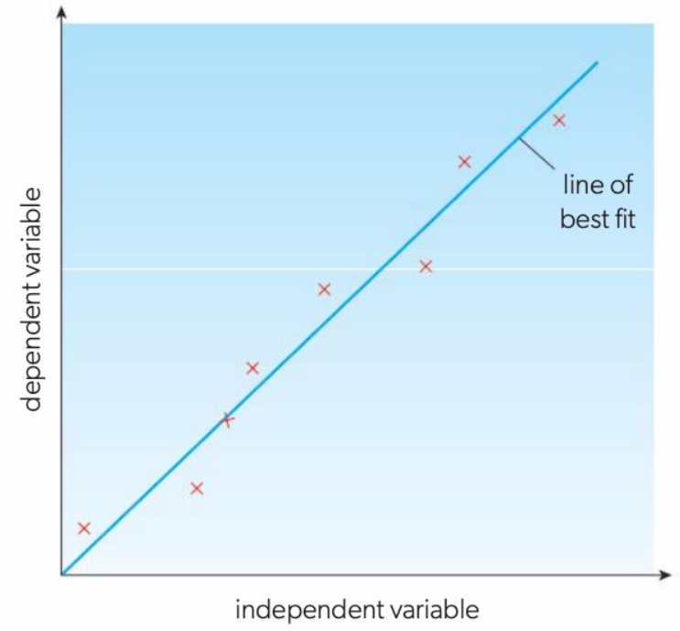
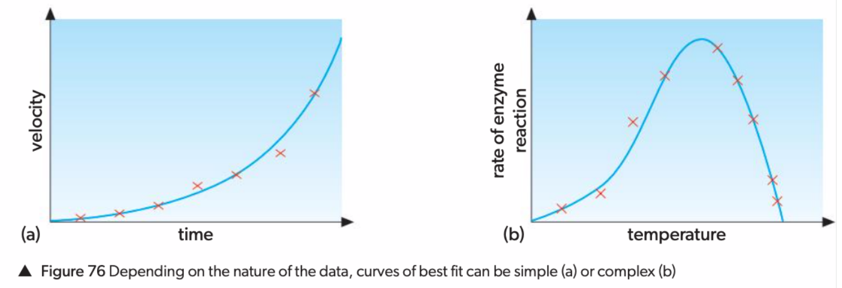

Slide 92
The presence of an outlier suggests that some of the data are unreliable.
This needs to be excluded for plotting the best-fit line.

Slide 93
Interpretation of features of graphs
The relationship between variables can be further analysed by interpreting the features of a graph: correlation, form, gradient, intercept, maxima and minima, and area. The main thing to remember is that the features of a graph can often represent an aspect of the idea being studied.
We will also discuss the use of a coefficient of determination (R²), interpolation and extrapolation.

Slide 94
Correlation
The first thing to consider when interpreting a graph is the correlation it shows (if any). If the dependent (y) variable increases when the independent variable (x) increases, then the variables are positively correlated. A negative correlation describes a relationship where an increase of the independent variable causes the dependent variable to decrease. If the points are randomly scattered in the graph, the correlation is weak or absent.
The relationships shown in graphs can be linear or non-linear. A linear relationship corresponds to a straight line in the graph that is described by the equation
y = kx + b
where k is the gradient (slope) of the line and b is the y-intercept.
Direct proportionality is a special type of linear relationship, in which the two variables are in a constant ratio. When one variable increases, the other increases by the same rate. For example, the volume of a gas is directly proportional to its temperature, provided that the temperature is in kelvin.
If two variables are directly proportional, the straight-line graph must go through the origin.

Slide 95
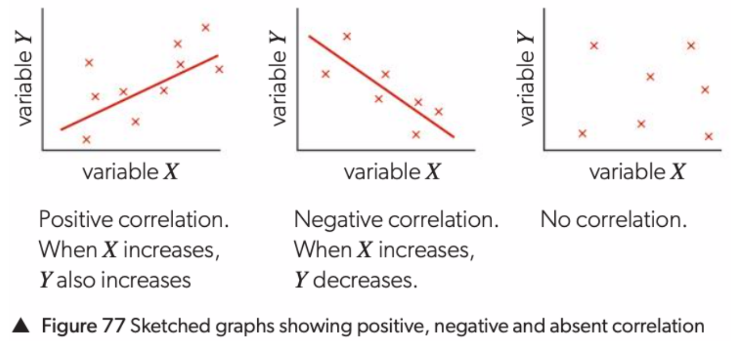
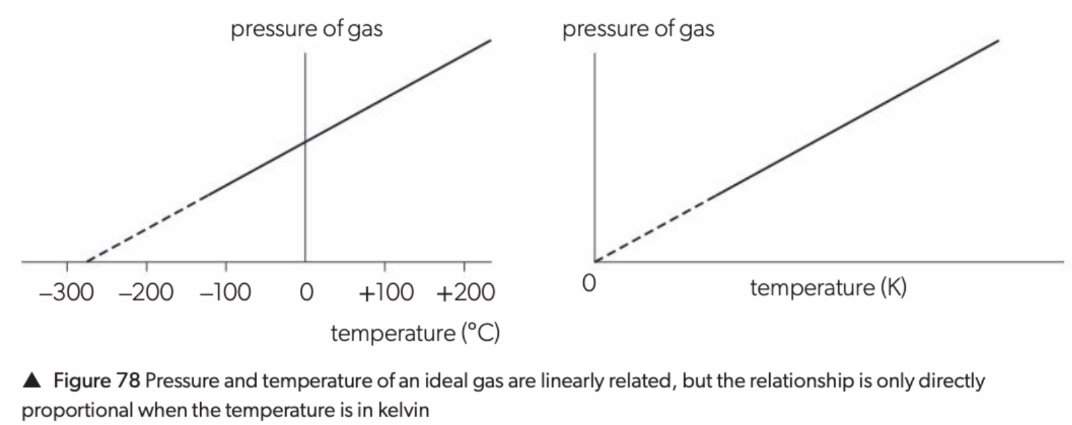

Slide 96
Variables are inversely proportional when one increases and the other decreases by the same rate.
Unlike direct proportionality, graphs showing inverse proportionality are not linear.
Plotting one of the variables in its reciprocal form, however, gives a straight-line graph.
The relationship between pressure andvolume of an ideal gas is a good example of inverse proportionality.

Slide 97
The pressure is inversely proportional to the volume.
This relationship is clearly seen when a graph of 1/V against P gives a straight line passing through the origin at constant temperature

Slide 98
Choosing what to plot to produce a straight line
Sometimes the data need to be processed in order to produce a straight line.
For example, when the relationship between the pressure and volume of a gas is investigated, the ideal gas equation PV = nRT can be rearranged to give a straight line graph when P is plotted against 1/V:

Slide 99
Non-linear is a term that includes all relationships that are not straight lines.
Sometimes, non-linear relationships can be described by functions, such as exponential, logarithmic and quadratic functions.

Slide 100
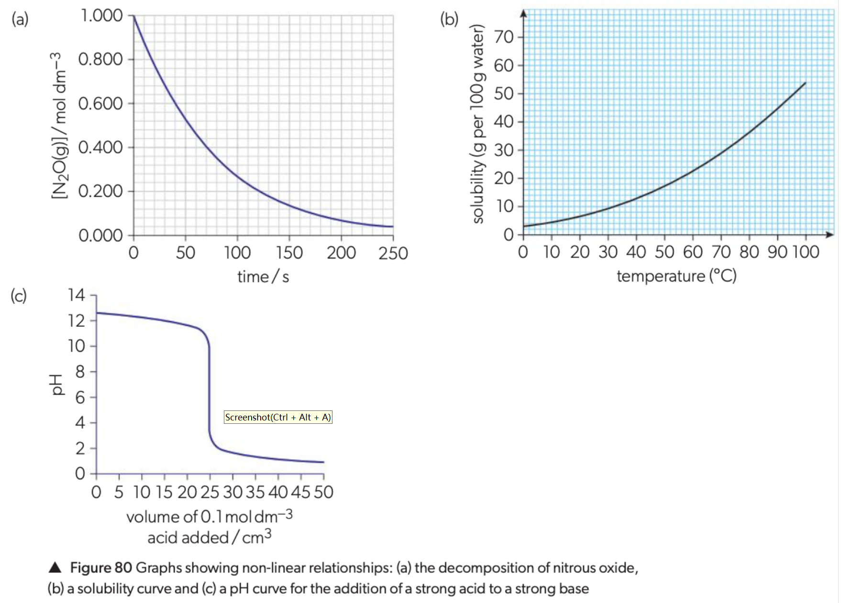

Slide 101
The process of assuming that the trend line applies between two points is called interpolation.
Two properties of a straight line are particularly useful: the gradient and the intercept.

Slide 102
Gradient
The gradient (or slope) of a line is a measure of its steepness, but it also has a physical meaning: it is the rate of change of one variable with respect to the other variable.
To find the gradient of a line, you need to choose two points on that line, ideally well separated from each other.
Gradients can be positive or negative, depending on whether the graph shows a positive or a negative correlation, respectively.
k = Δy/Δx = (y₂ − y₁) / (x₂ − x₁)
For example, a graph of mass of a substance (along the y-axis, in g) vs its volume (along the x-axis, in cm³) gives a straight line. The gradient of the line has units g cm⁻³, which gives us the density of that substance.
The uncertainty for the gradient can be determined by drawing the steepest and most gradual lines of best fit possible within the constraints of the error bars, giving values for maximum and minimum gradients.
Half the difference between these two lines can be used to estimate the uncertainty of the gradient.

Slide 103
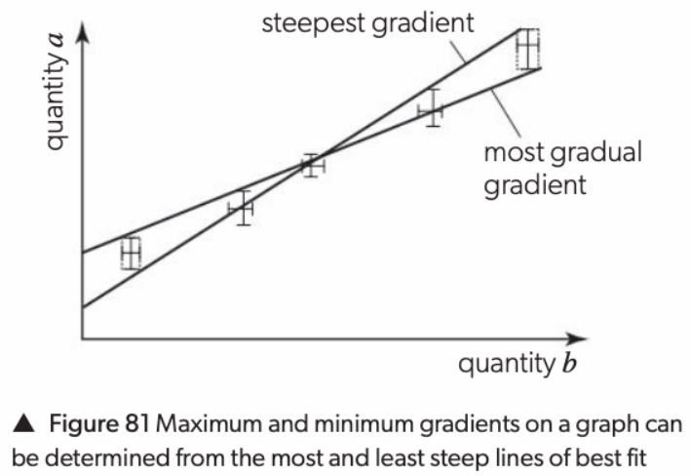

Slide 104
Straight-line graphs have constant gradients while curves have changing gradients.
For instance, data for product volume vs time will produce a curve, because the rate decreases during the reaction.
We can determine the gradient at a specific point on the curve by drawing a tangent line and working out its gradient.
In Figure 82, two tangent lines are shown in green. The one at t = 0 is clearly steeper because the rate is higher at that point in time.
Figure 83 shows how to calculate the gradient of a tangent line.

Slide 105
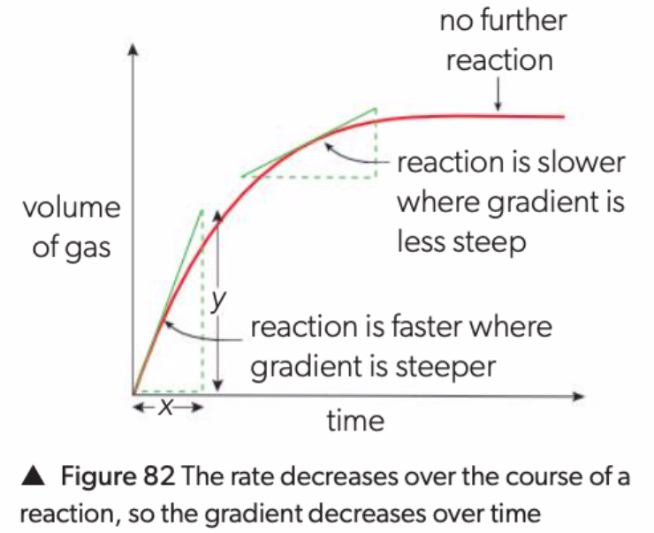

Slide 106
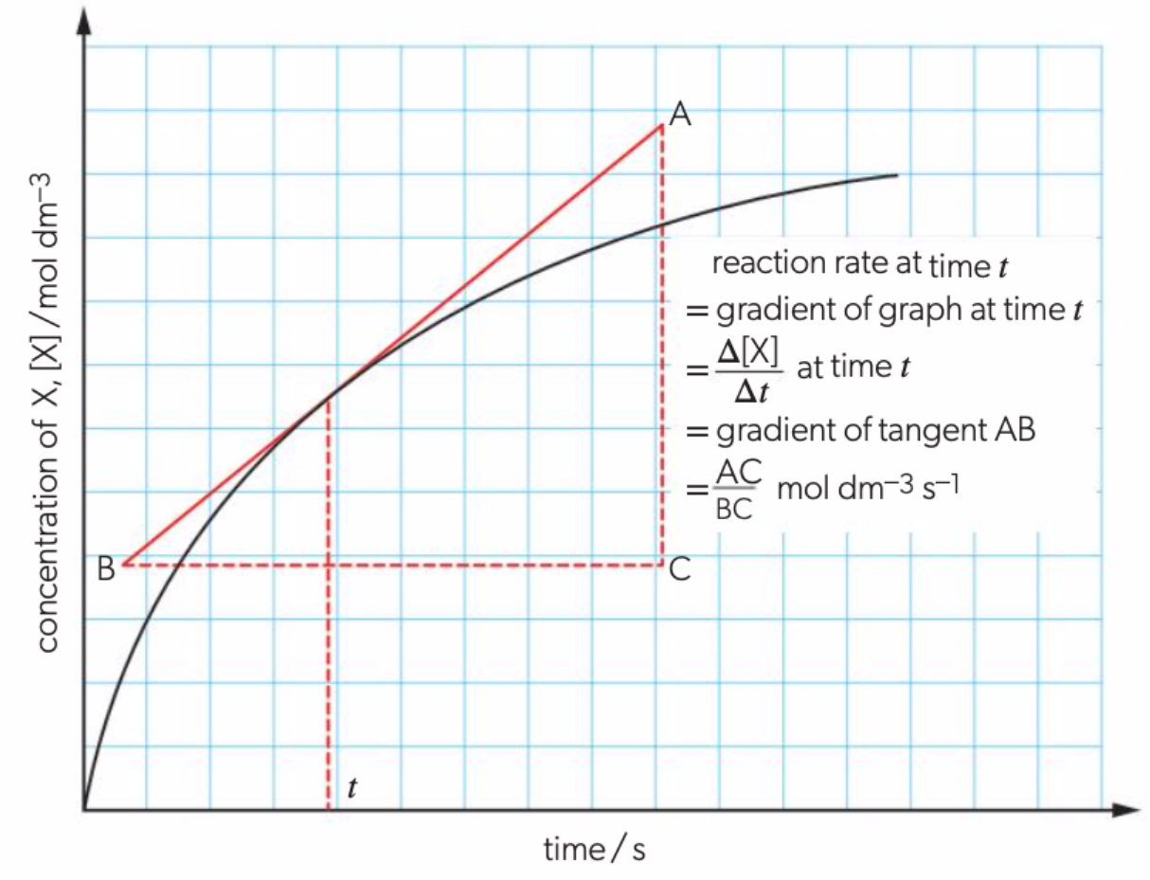

Slide 107
Intercepts
The intercepts are the points where the line or curve crosses the axes.
Intercepts can be found by extending the line until it meets the axis (this is called extrapolation).
You can also use the equation of the line in the form y = kx + b where b represents the y-intercept.
As with gradient, the significance of the intercepts depends on the context of the data being plotted.
In some cases, you would expect the y-intercept to be 0, for instance when plotting the concentration of a product vs time as a part of a kinetics investigation.
In other cases, the intercept can be used to derive a numerical quantity.
Similar to gradient, the uncertainty of the y-intercept can be determined by drawing the most and least steep lines of best fit possible within the constraints of the error bars.
This gives maximum and minimum values for the y-intercept, from which you can find the uncertainty.

Slide 108
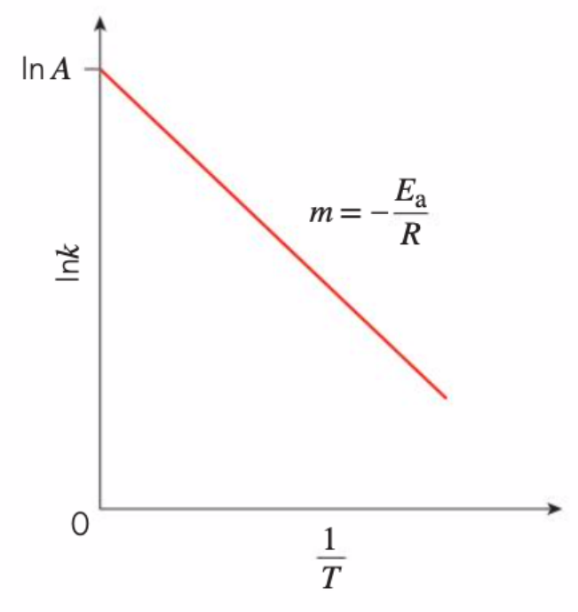
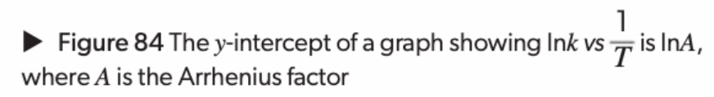

Slide 109
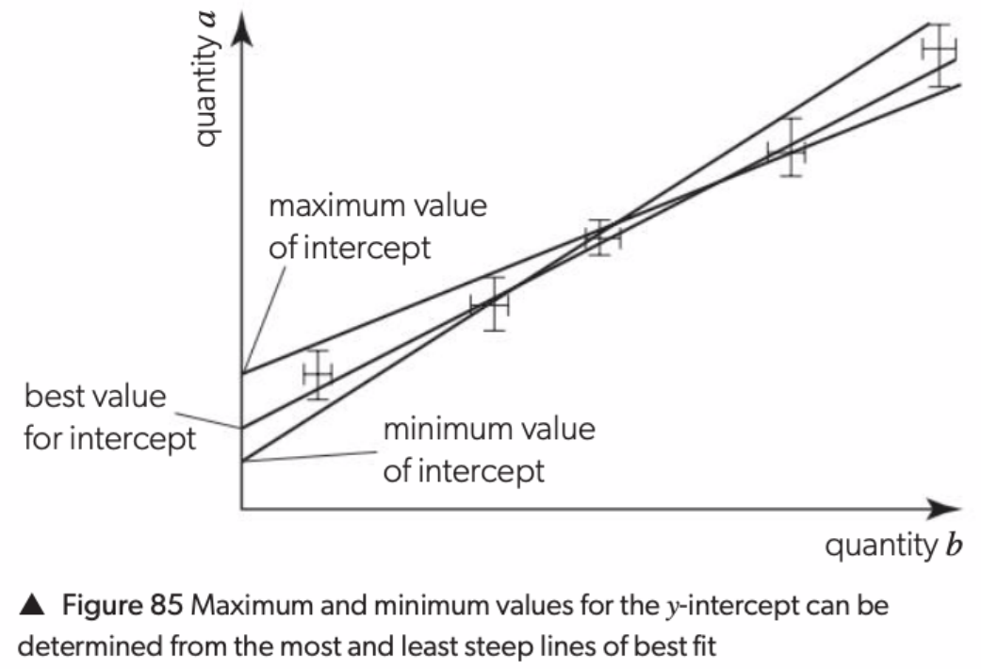

Slide 110
Interpolation and extrapolation
Lines and curves of best fit can be interpolated or extrapolated.
Interpolation involves predicting values within the range of the experimental data, whereas extrapolation involves predicting values outside the range of these data (Figure 90).
Consider the absorbance versus concentration graph shown in Figure 91.
The points on the line were obtained by measuring the absorbance of six solutions of known concentration.
The absorbance of a sample of unknown concentration is found to be 0.460.
Its concentration can then be found by interpolation, as shown, giving 0.34 mol dm⁻³. If known, the equation of the line could also be used to find the concentration, by entering 0.460 in for y and solving for x

Slide 111
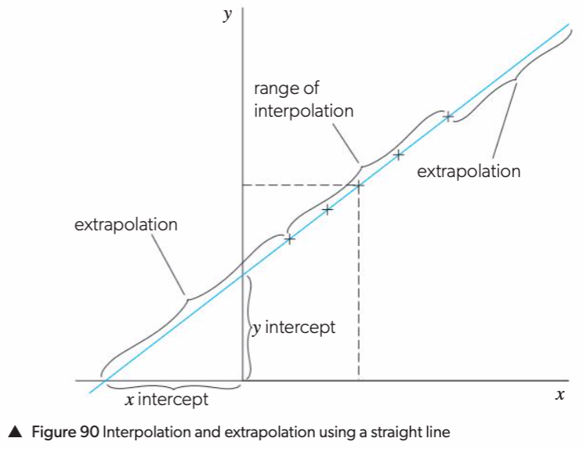

Slide 112
In a calorimetry experiment, the temperature of the reaction mixture containing copper(II) sulfate solution and zinc metal is monitored over time and the results are plotted on a graph.
The maximum temperature value is needed to calculate ∆T and subsequently the amount of heat, Q (and later, the enthalpy change, ∆H). The highest temperature measured during the experiment is lowered due to heat loss to the surroundings.
Extrapolating the cooling curve (the part of the graph that shows a decreasing temperature over time) backwards to the time at which the zinc was added to the copper(II) sulfate solution, allows us to predict a corrected value of Tmax. Doing so assumes a constant rate of heat loss during the reaction.
Extrapolation always involves the assumption that the relationship between variables stays the same beyond the range of data. In practice, this is not always the case. For example, the relationship between absorbance and concentration in Figure 91 is linear, but the linearity is lost at higher concentration.

Slide 113
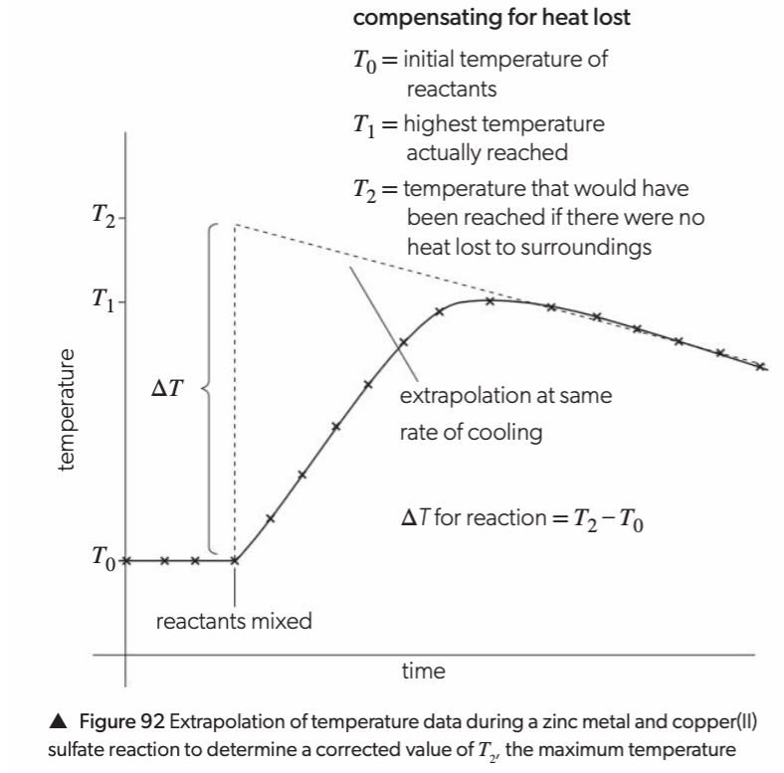


Slide 114


Slide 115


Slide 116
Maxima, minima and areas on graphs
Further interpretation of graphs may involve inspecting maximum values, minimum values or the area under a curve.
The significance of each of these depends on the variables being represented in the graph.
The absorbance spectrum of a solution of an unknown substance shows a maximum at around 520nm, which corresponds to the green region of the visible spectrum.
The colour of the unknown solution must be red, as it is complementary to green.

Slide 117


Slide 118

The changes in the concentrations of ozone, O₃, and chlorine monoxide radicals, ClO•, 18km high in the atmosphere across different latitudes are shown in Figure 87.
The minimum in ozone concentration occurs at the same point as a maximum in ClO• concentration, suggesting an association between low ozone levels and high ClO• levels.

Slide 119
The area under a curve (or the area under a graph) is the area enclosed by the curve and x-axis.
It represents an accumulation of the y-axis variable over the course of a certain x-axis variable change.
The area under the curve is useful in Maxwell–Boltzmann distributions, where it represents the number of particles in the sample. Figure 88 shows the Maxwell–Boltzmann distributions for the same species at two different temperatures.
The particles that have sufficient energy to react are represented by the shaded regions. Their kinetic energy is equal to or greater than the activation energy, E_{a}.
At the higher temperature, T₂, the shaded area is larger (red + green) and therefore the number of particles with sufficient energy to react is higher than at T₁, at which the shaded area is smaller (red only).

Slide 120


Slide 121
Errors and graphs
Systematic errors and random uncertainties can often be recognized from a graph.
A graph combines the results of many measurements and so minimizes the effects of random uncertainties in the measurements.

Slide 123
Error Bars
Error bars (also known as uncertainty bars) are graphical representations of uncertainties, effectively showing that a data point represents a range of values.
Vertical error bars show the uncertainty of the y-axis variable, whereas horizontal error bars show the uncertainty of the x-axis variable.
Graph-plotting software often has an option to include error bars when the absolute or percentage uncertainty is specified.
However, if there is a different uncertainty associated with each point, the software might not accommodate this. In this case you can either draw the error bars for each point by hand or have the program draw error bars corresponding to the largest uncertainty in the data set (and add a note to this effect). You should determine which option is best in the context of your analysis.

Slide 124


Slide 125


Slide 126


Slide 127


Slide 128


Slide 129
Coefficient of determination, R²
We have seen that all measurements, and data derived from them, have an associated uncertainty. As a result of this, the data points in a graph are not likely to fall directly on the line of best fit, but rather be scattered on either side of it.
One of the tools we can use to assess the predictive power of the relationship between the variables in a graph is R², the coefficient of determination.
In DP chemistry, you will use technology to find R² values, and you will be expected to interpret them. However, you will not be required to calculate R² yourself.
The value of R² lies between 0 and 1.
The closer it is to 1, the more closely the data points match the line of best fit and the more successful the model is at predicting the changes in the y-axis variable.
R² is only suitable for linear models.

Slide 130


